Slide 1
Background & Context
Background:
The scientific community has estimated that there are around 5.1 million species of fungi in the world. In North America alone, we have 10,000 species of identified fleshy fungi (mushrooms), estimated at 20% - 30% of known species in our continent. While 29% of the known species are edible, 71% of these known species are inedible. Furthermore, 20% of these inedible mushrooms can make you sick, while 1% are fatal. Mushroom misidentification is a major problem in some part of the world that include fungi as a regular dietary item. Just this year in Iran, more than 800 people got sick from accidentally ingesting the Death Cap mushroom (Amanita Phalloides). The Death Cap is often misidentified by local street vendors who rely on folk wisdom to identify edible mushrooms.
Strategy:
With 11 confirmed fatalities from the Iran mushroom poisoning tragedy and no effective treatment for this kind of poisoning, the United Nations would like to deploy a model to help locals differentiate between edible and poisonous mushrooms. The model must use qualitative characteristics as this information can be identified by locals with standard human faculties and will allow for a broader application.
Our Task:
The client (United Nations) is looking for our expertise to develop a model to help locals identify potentially poisonous mushrooms using qualitative characteristics.

Slide 2
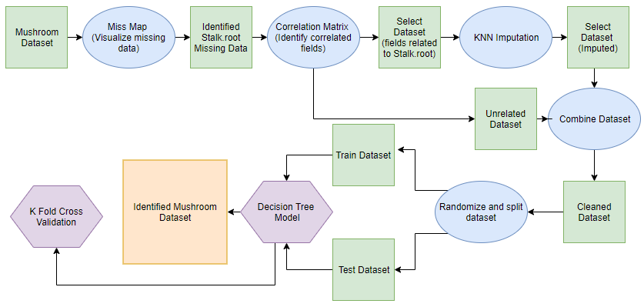
Analytical Solution
Identify physical characteristics of mushrooms that are common amongst poisonous and edible mushrooms and apply machine learning to model which mushrooms are most likely to be poisonous.

Slide 3
Data Understanding
In this dataset we have 23 features (22 categorical, 0 numerical), and 1 target variable.
Target Variables
class | poisonous*
*classified as poisonous in model
Categorical Features
cap.shape
cap.surface
cap.color
bruises
odor
gill.attachment
gill.spacing
gill.size
gill.color
stalk.shape
stalk.root
stalk.surface.above.ring
stalk.surface.below.ring
stalk.color.above.ring
stalk.color.below.ring
veil.color
ring.number
ring.type
spore.print.color
population
habitat

Slide 4
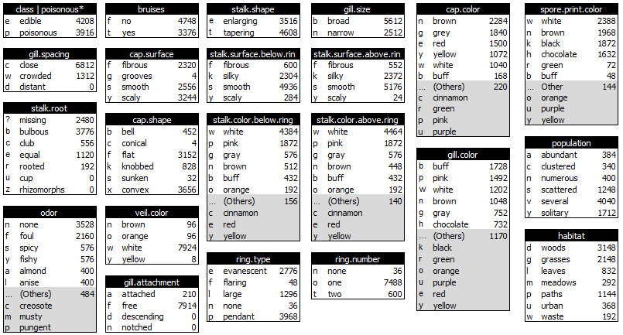
Data Understanding

Slide 5
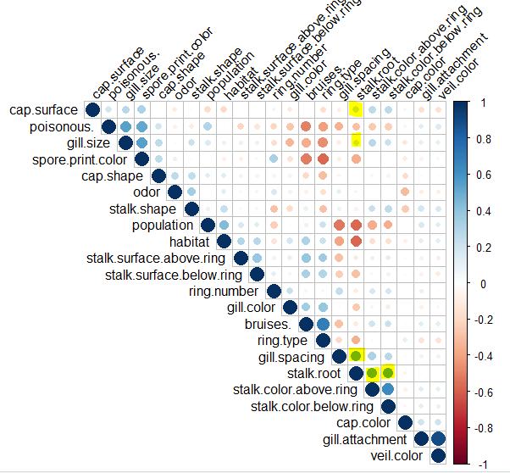
Data Exploration
Correlogram
The veil.type attribute was causing errors with the correlogram and was removed when creating the correlogram. No significant data was lost as all instances had the same value.
#convert factor categories to numeric categories mush_matrix=data.matrix(mush) str(mush_matrix)
cor_result=rcorr(mush_matrix) #Advanced Corr matrix cor_result$r #Extract the correlation coefficients corrplot(cor_result$r, type = "upper", order = "hclust", tl.col = "black", tl.srt = 45)

Slide 6
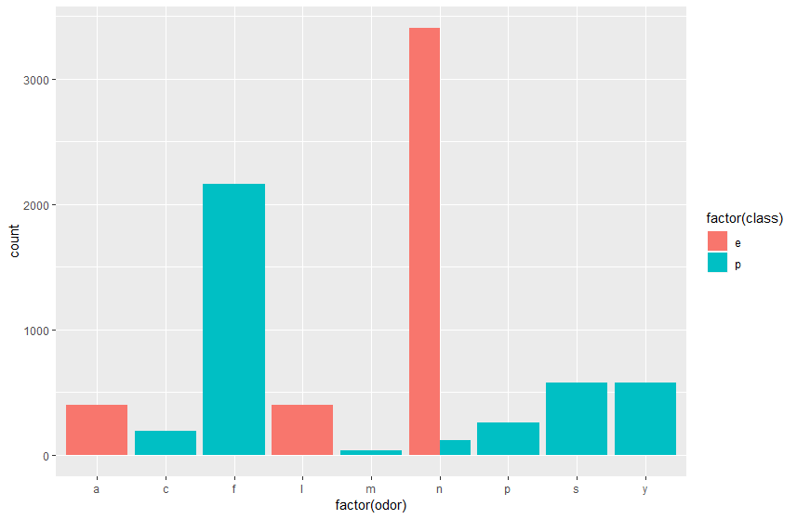
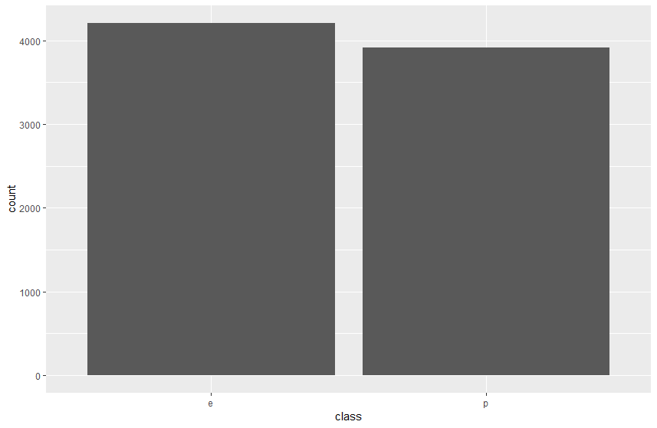
Data Exploration
Distribution of Class
e = edible | p = poisonous
Distribution of Class by Odor
e = edible | p = poisonous
a = almond|c = creosote|f = foul|l = anise
m = musty|n = none|p = pungent|s = spicy|y = fishy

Slide 7
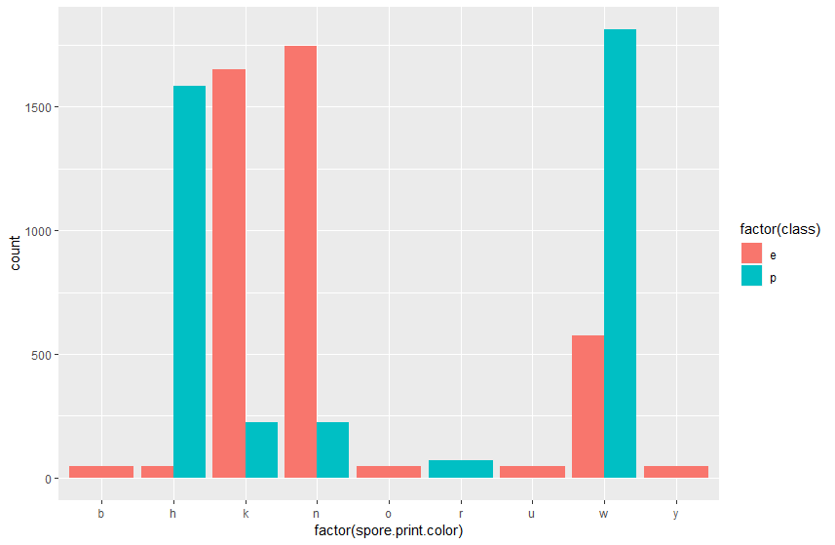
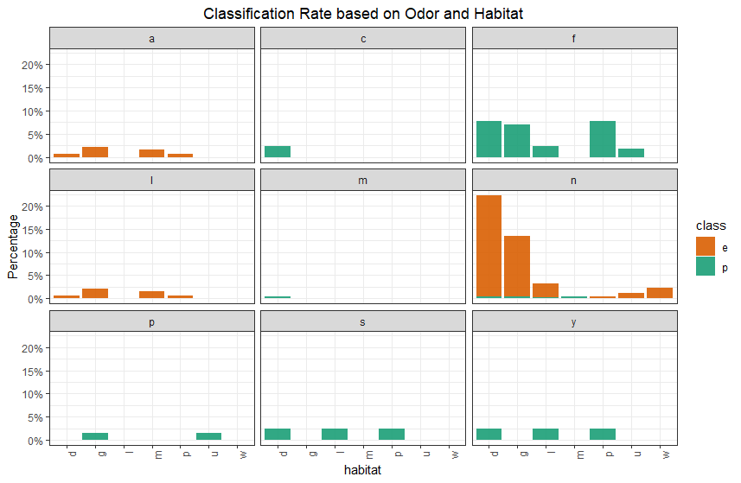
Data Exploration
Distribution of Class by Spore.Print.Color
e = edible | p = poisonous
b = buff|h = chocolate|k = black|n = brown
o = orange|r = green|u = purple|w = white|y = yellow
Class based on Odor and Habitat
e = edible | p = poisonous
d = woods|g = grasses|l = leaves|m = meadows
p = paths|u = urban|w = waste
a = almond|c = creosote|f = foul|l = anise
m = musty|n = none|p = pungent|s = spicy|y = fishy

Slide 8
Data Preparation
Only the stalk.root attribute contained missing values (2480 missing entries), missing values are detonated by “?” in the dataset.
Using the correlogram, we can pinpoint variables that have a correlation to stalk.root
stalk.color.above.ring
stalk.color.below.ring
cap.surface
gill.size
gill.spacing
Using KNN imputation on the isolated dataframe with the selected attributes, approximated values were generated then merged with our original dataset.
#separate mush data into mush_select mush_select=mush[,c("stalk.color.above.ring","stalk.color.below.ring","cap.surface","gill.size","gill.spacing","stalk.root")] mush_other = mush[,-which(names(mush)%in% names(mush_select))] #KNN Imputation on mush_select library(VIM) knnoutput = kNN(mush_select, k = 5) summary (knnoutput)

Slide 9
Data Preparation
Outliers - As our data is mainly categorical and size of our dataset the influence of outliers is considered insignificant to our model.
Categorical Features - as we are using a decision tree model, there is no need to encode categorical features.
Other Transformations - veil.type attribute was removed as it was causing issues with the decision tree model.

Slide 10
Model Development
Code for Modeling:
set.seed(8124)
training = createDataPartition(mush_other$poisonous., p=0.6,list = FALSE)
train_cleaned = mush_other[training,]
test_cleaned = mush_other[-training,]
test_poisonous = test_cleaned$poisonous.
test_cleaned$poisonous.=NULL
Cleaned data set(No missing value) is separated to 60% training data and 40% test data.
Column poisonous is removed from TEST data for prediction.

Slide 11
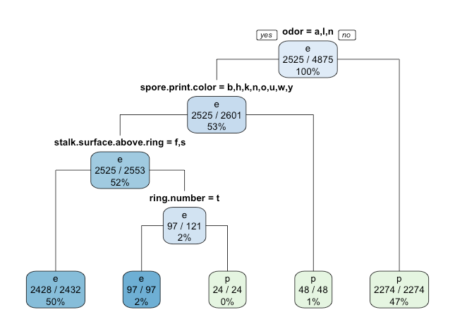
Model Development
Decision Tree Model:
DT <- rpart(poisonous. ~., train_cleaned, method = "class", cp=0)
summary(DT)
printcp(DT)
rpart.plot(DT, type=1, extra = 102)

Slide 12
Model Development
K Fold Cross Validation:
CART
4875 samples
15 predictor
2 classes: 'e', 'p'
No pre-processing
resampling: Cross-Validated (10 fold)
Summary of sample sizes: 4387, 4388, 4387, 4388, 4388, 4387, ...
Resampling results:
Accuracy Kappa
0.9991795 0.9983566
Tuning parameter 'cp' was held constant at a value of 0
The original sample is randomly partitioned into k equal size subsamples.
The cross-validation process is then repeated 10 times, with each of the k subsamples used exactly once as the validation data.
Accuracy: 0.9991795

Slide 13
Outcome
Poisonous Confusion Matrix
 |  | Predicted
 |  | NO | YES
Actual | NO | 1683 | 0 | 1683
 | YES | 2 | 1564 | 1566
 |  | 1685 | 1564
Accuracy (TP + TN)/Total | 99.94%
Misclassification rate (FP + FN)/Total | 0.06%
True Positive rate (TP/Actual YES) | 99.87%
False Positive rate (TP/Actual NO) | 0.00%
Specificity (TN/Actual NO) | 100.00%
Precision (TP/Predicted YES) | 100.00%
Prevalence (Actuals YES/Total) | 48.20%

Slide 14
Outcome
What does the decision tree tell us, how do you classify a poisonous mushroom?
The target variable (poisonous) contains two classes, edible or poisonous. The root of this tree contains 4875 observations.
The Poisonous Confusion Matrix based on the decision tree confirms the model accuracy of 99.94%.
The most influential attribute in classifying a poisonous mushroom is odor, 47% of mushroom can be classified as a poisonous based on the odor. The next attribute is classified based on the spore print colour, if the colour is green, then it is poisonous. Stalk colour below ring can further classify 50% of mushrooms as edible.
Using the model, you can classify a poisonous mushroom based on its odor, spore print colour and stalk colour below ring.

Slide 15
Outcome - cont’d
What does the decision tree tell us, how do you classify a poisonous mushroom?
Using the model, we can predict 99.8% of the outcome if a mushroom is poisonous. However, if the outcome was false negative, we are hesitant to apply this model to an actual scenario.
Knowing only 20-30% of the world’s mushroom species have been identified, we cannot be certain of the integrity of the model when applied to unknown species, undiscovered species.
The model could be strengthened by training with localized mushroom datasets (species of mushrooms native to a deployment region) to enhance performance and application. While a certain level of uncertainty will remain, the model can serve to help curb the abundance of poisonous mushrooms in the food chain.

